Slide 1

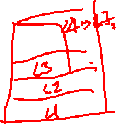
Chapter 5
End-to-End Protocols
This work is licensed under a Creative Commons Attribution 4.0 License.

Slide 2
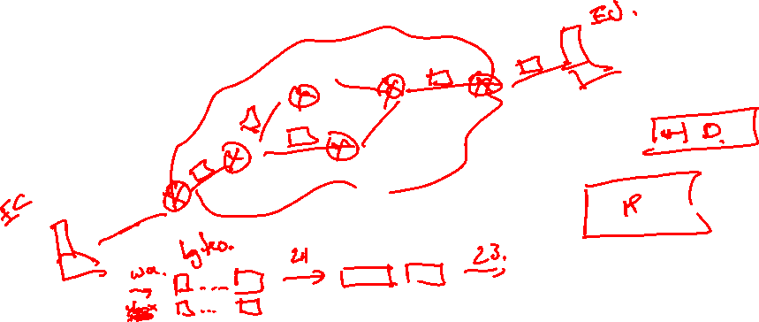
Problem
How to turn this host-to-host packet delivery service into a process-to-process communication channel

Slide 3

Chapter Outline
Simple Demultiplexer (UDP)
Reliable Byte Stream (TCP)
Remote Procedure Call (RPC)

Slide 4
Chapter Goal
Understanding the demultipexing service
Discussing reliable byte-stream protocol
Understand how RPC works and how it relates to transport protocols

Slide 5
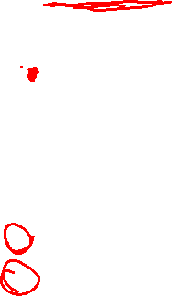
End-to-end Protocols
Common properties that a transport protocol can be expected to provide
Guarantees message delivery
Delivers messages in the same order they were sent
Delivers at most one copy of each message
Supports arbitrarily large messages
Supports synchronization between the sender and the receiver
Allows the receiver to apply flow control to the sender
Supports multiple application processes on each host

Slide 6
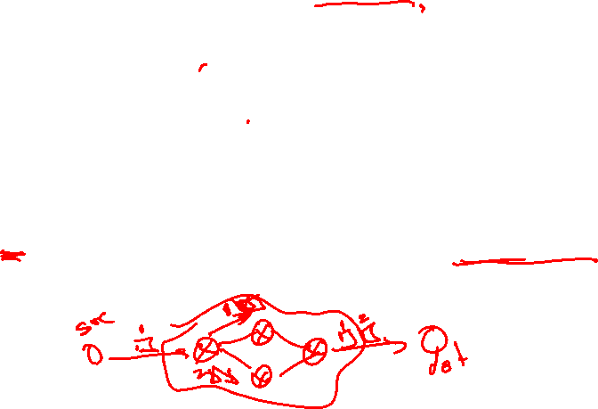
End-to-end Protocols
Typical limitations of the network on which transport protocol will operate
Drop messages
Reorder messages
Deliver duplicate copies of a given message
Limit messages to some finite size
Deliver messages after an arbitrarily long delay

Slide 7
End-to-end Protocols
Challenge for Transport Protocols
Develop algorithms that turn the less-than-desirable properties of the underlying network into the high level of service required by application programs

Slide 8
Simple Demultiplexer (UDP)
Extends host-to-host delivery service of the underlying network into a process-to-process communication service
Adds a level of demultiplexing which allows multiple application processes on each host to share the network

Slide 9
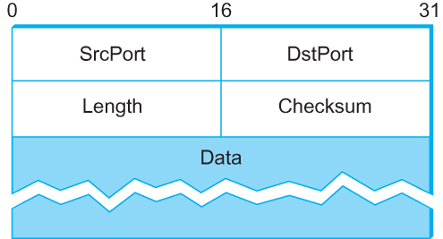
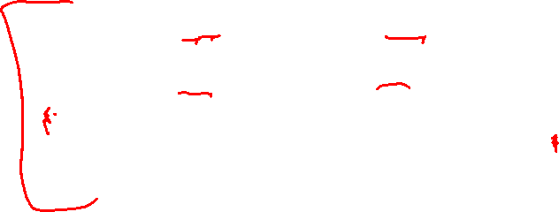
Simple Demultiplexer (UDP)
Format for UDP header (Note: length and checksum fields should be switched)

Slide 10
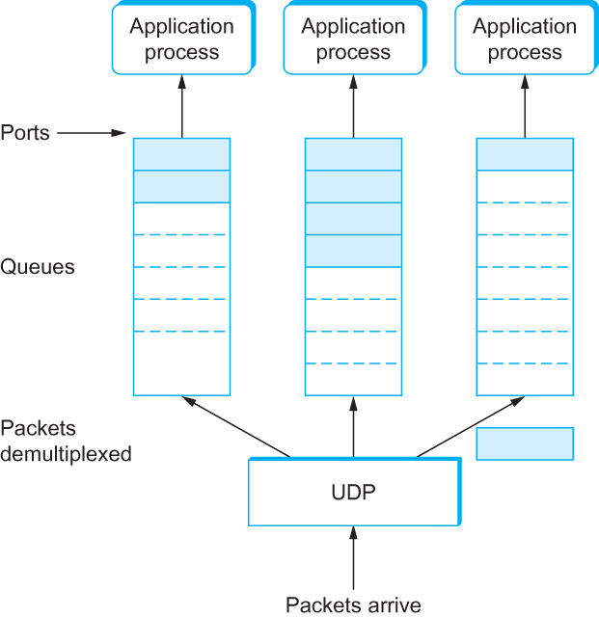
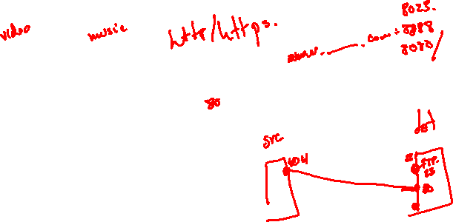
Simple Demultiplexer (UDP)
UDP Message Queue

Slide 11
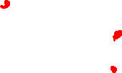
Reliable Byte Stream (TCP)
In contrast to UDP, Transmission Control Protocol (TCP) offers the following services
Reliable
Connection oriented
Byte-stream service

Slide 12
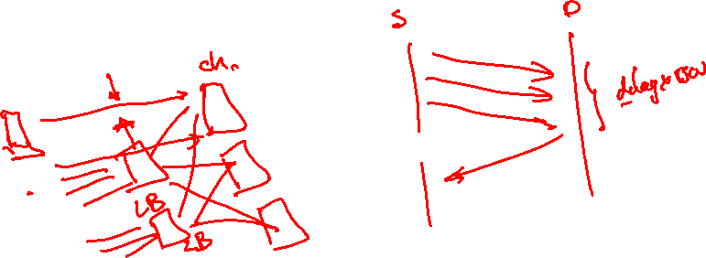
Flow control VS Congestion control
Flow control involves preventing senders from overrunning the capacity of the receivers
Congestion control involves preventing too much data from being injected into the network, thereby causing switches or links to become overloaded

Slide 13
End-to-end Issues
At the heart of TCP is the sliding window algorithm (discussed in Chapter 2)
As TCP runs over the Internet rather than a point-to-point link, the following issues need to be addressed by the sliding window algorithm
TCP supports logical connections between processes that are running on two different computers in the Internet
TCP connections are likely to have widely different RTT times
Packets may get reordered in the Internet

Slide 14
End-to-end Issues
TCP needs a mechanism using which each side of a connection will learn what resources the other side is able to apply to the connection
TCP needs a mechanism using which the sending side will learn the capacity of the network

Slide 15
TCP Segment
TCP is a byte-oriented protocol, which means that the sender writes bytes into a TCP connection and the receiver reads bytes out of the TCP connection.
Although “byte stream” describes the service TCP offers to application processes, TCP does not, itself, transmit individual bytes over the Internet.

Slide 16
TCP Segment
TCP on the source host buffers enough bytes from the sending process to fill a reasonably sized packet and then sends this packet to its peer on the destination host.
TCP on the destination host then empties the contents of the packet into a receive buffer, and the receiving process reads from this buffer at its leisure.
The packets exchanged between TCP peers are called segments.

Slide 17
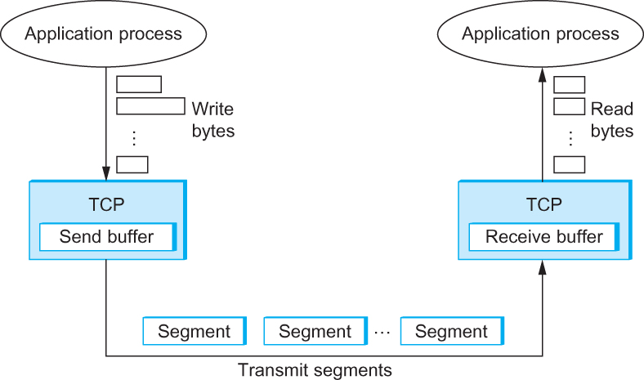
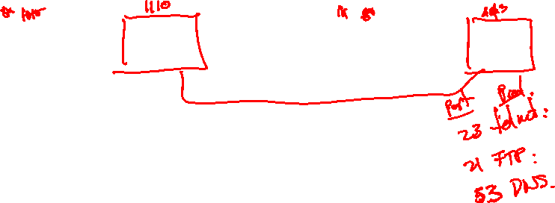
TCP Segment
How TCP manages a byte stream.

Slide 18
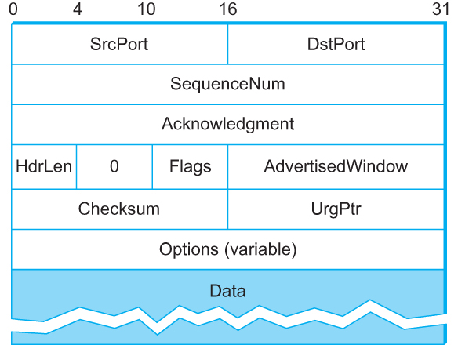
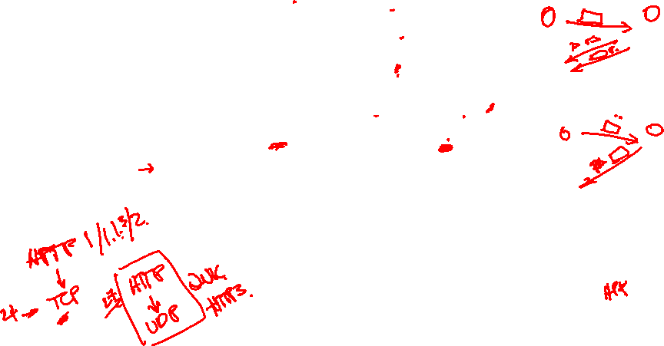
TCP Header
TCP Header Format

Slide 19
TCP Header
The SrcPort and DstPort fields identify the source and destination ports, respectively.
The Acknowledgment, SequenceNum, and AdvertisedWindow fields are all involved in TCP’s sliding window algorithm.
Because TCP is a byte-oriented protocol, each byte of data has a sequence number; the SequenceNum field contains the sequence number for the first byte of data carried in that segment.
The Acknowledgment and AdvertisedWindow fields carry information about the flow of data going in the other direction.

Slide 20
TCP Header
The 6-bit Flags field is used to relay control information between TCP peers.
The possible flags include SYN, FIN, RESET, PUSH, URG, and ACK.
The SYN and FIN flags are used when establishing and terminating a TCP connection, respectively.
The ACK flag is set any time the Acknowledgment field is valid, implying that the receiver should pay attention to it.

Slide 21
TCP Header
The URG flag signifies that this segment contains urgent data. When this flag is set, the UrgPtr field indicates where the nonurgent data contained in this segment begins.
The urgent data is contained at the front of the segment body, up to and including a value of UrgPtr bytes into the segment.
The PUSH flag signifies that the sender invoked the push operation, which indicates to the receiving side of TCP that it should notify the receiving process of this fact.
Finally, the RESET flag signifies that the receiver has become confused

Slide 22
TCP Header
Finally, the RESET flag signifies that the receiver has become confused, it received a segment it did not expect to receive—and so wants to abort the connection.
Finally, the Checksum field is used in exactly the same way as for UDP—it is computed over the TCP header, the TCP data, and the pseudoheader, which is made up of the source address, destination address, and length fields from the IP header.

Slide 23
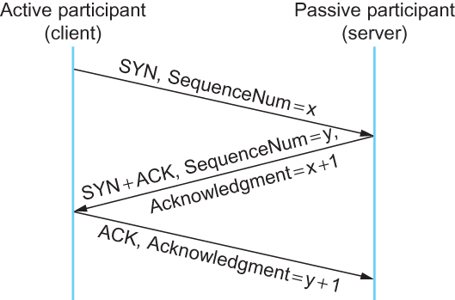
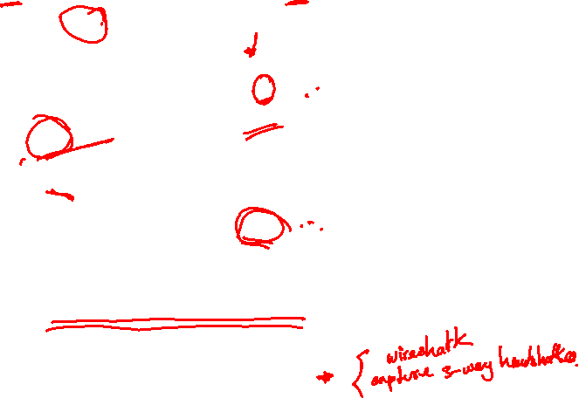
Connection Establishment/Termination in TCP
Timeline for three-way handshake algorithm

Slide 24
Sliding Window Revisited
TCP’s variant of the sliding window algorithm, which serves several purposes:
(1) it guarantees the reliable delivery of data,
(2) it ensures that data is delivered in order, and
(3) it enforces flow control between the sender and the receiver.

Slide 25
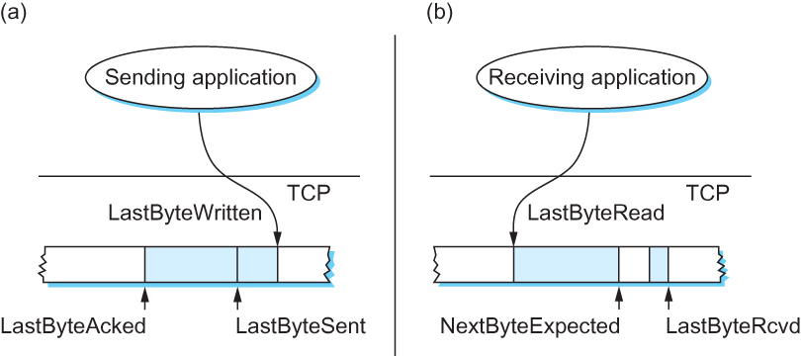
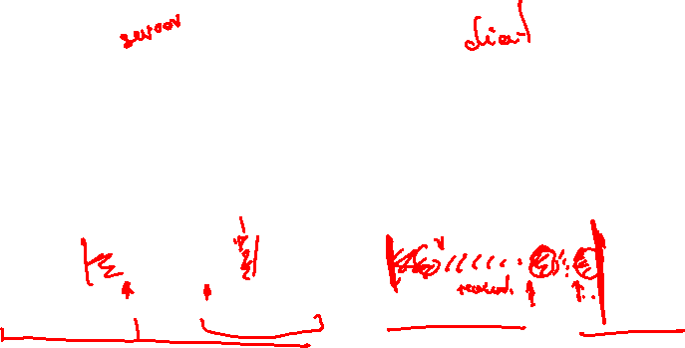
Sliding Window Revisited
Relationship between TCP send buffer (a) and receive buffer (b).

Slide 26

TCP Sliding Window
Sending Side
LastByteAcked ≤ LastByteSent
LastByteSent ≤ LastByteWritten
Receiving Side
LastByteRead < NextByteExpected
NextByteExpected ≤ LastByteRcvd + 1

Slide 27
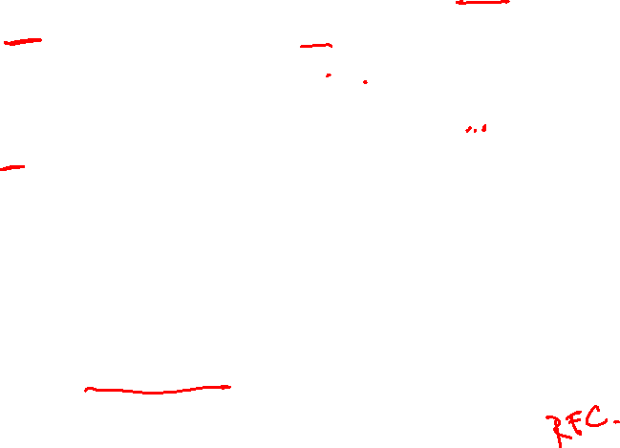
TCP Flow Control
LastByteRcvd − LastByteRead ≤ MaxRcvBuffer
AdvertisedWindow = MaxRcvBuffer − ((NextByteExpected − 1) − LastByteRead)
LastByteSent − LastByteAcked ≤ AdvertisedWindow
EffectiveWindow = AdvertisedWindow − (LastByteSent − LastByteAcked)
LastByteWritten − LastByteAcked ≤ MaxSendBuffer
If the sending process tries to write y bytes to TCP, but
(LastByteWritten − LastByteAcked) + y > MaxSendBuffer
then TCP blocks the sending process and does not allow it to generate more data.

Slide 28
Protecting against Wraparound
SequenceNum: 32 bits longs
AdvertisedWindow: 16 bits long
TCP has satisfied the requirement of the sliding
window algorithm that is the sequence number
space be twice as big as the window size
2³² >> 2 × 2¹⁶

Slide 29
Protecting against Wraparound
Relevance of the 32-bit sequence number space
The sequence number used on a given connection might wraparound
A byte with sequence number x could be sent at one time, and then at a later time a second byte with the same sequence number x could be sent
Packets cannot survive in the Internet for longer than the MSL
MSL is set to 120 sec
We need to make sure that the sequence number does not wrap around within a 120-second period of time
Depends on how fast data can be transmitted over the Internet

Slide 30
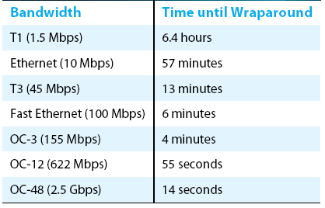

Protecting against Wraparound
Time until 32-bit sequence number space wraps around.

Slide 31
Keeping the Pipe Full
16-bit AdvertisedWindow field must be big enough to allow the sender to keep the pipe full
Clearly the receiver is free not to open the window as large as the AdvertisedWindow field allows
If the receiver has enough buffer space
The window needs to be opened far enough to allow a full
delay × bandwidth product’s worth of data
Assuming an RTT of 100 ms

Slide 32
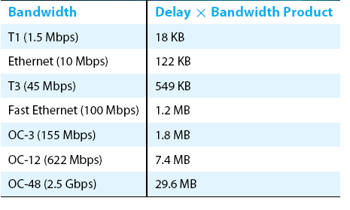
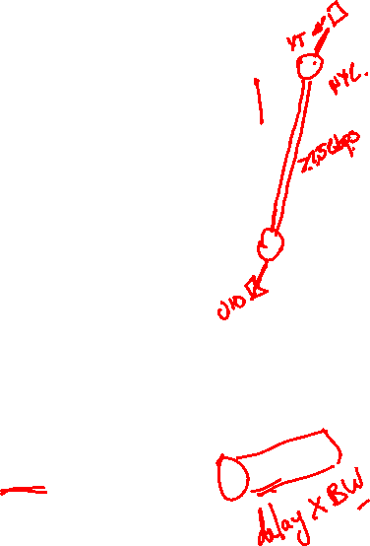
Keeping the Pipe Full
Required window size for 100-ms RTT.

Slide 33
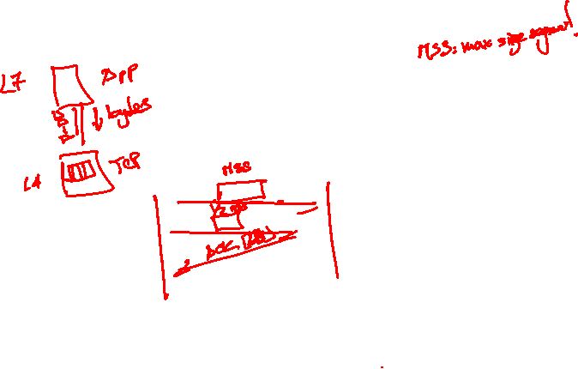
Triggering Transmission
How does TCP decide to transmit a segment?
TCP supports a byte stream abstraction
Application programs write bytes into streams
It is up to TCP to decide that it has enough bytes to send a segment

Slide 34
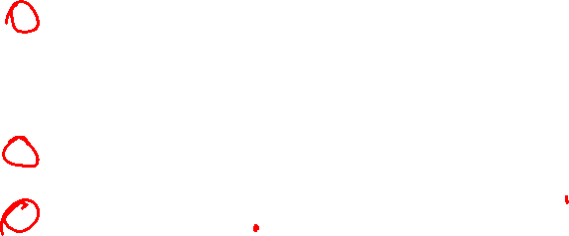
Triggering Transmission
What factors governs this decision
Ignore flow control: window is wide open, as would be the case when the connection starts
TCP has three mechanism to trigger the transmission of a segment
1) TCP maintains a variable MSS and sends a segment as soon as it has collected MSS bytes from the sending process
MSS is usually set to the size of the largest segment TCP can send without causing local IP to fragment.
MSS: MTU of directly connected network – (TCP header + and IP header)
2) Sending process has explicitly asked TCP to send it
TCP supports push operation
3) When a timer fires
Resulting segment contains as many bytes as are currently buffered for transmission

Slide 35
Silly Window Syndrome
If you think of a TCP stream as a conveyer belt with “full” containers (data segments) going in one direction and empty containers (ACKs) going in the reverse direction, then MSS-sized segments correspond to large containers and 1-byte segments correspond to very small containers.
If the sender aggressively fills an empty container as soon as it arrives, then any small container introduced into the system remains in the system indefinitely.
That is, it is immediately filled and emptied at each end, and never coalesced with adjacent containers to create larger containers.

Slide 36
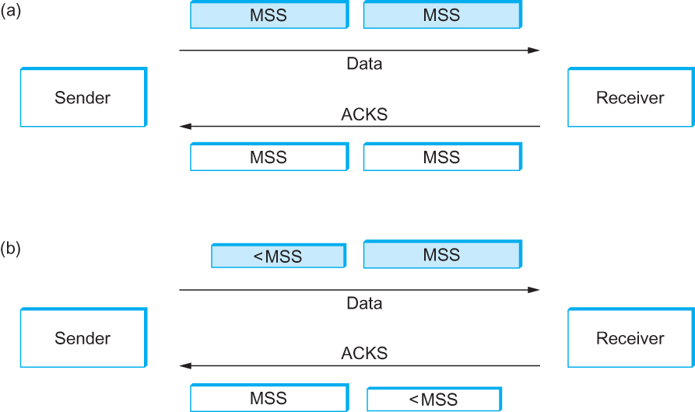

Silly Window Syndrome
Silly Window Syndrome

Slide 37
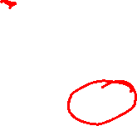
Nagle’s Algorithm
If there is data to send but the window is open less than MSS, then we may want to wait some amount of time before sending the available data
But how long?
If we wait too long, then we hurt interactive applications like Telnet
If we don’t wait long enough, then we risk sending a bunch of tiny packets and falling into the silly window syndrome
The solution is to introduce a timer and to transmit when the timer expires

Slide 38
Nagle’s Algorithm
We could use a clock-based timer, for example one that fires every 100 ms
Nagle introduced an elegant self-clocking solution
Key Idea
As long as TCP has any data in flight, the sender will eventually receive an ACK
This ACK can be treated like a timer firing, triggering the transmission of more data

Slide 39
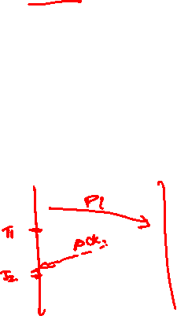
Nagle’s Algorithm
When the application produces data to send
if both the available data and the window ≥ MSS
send a full segment
else
if there is unACKed data in flight
buffer the new data until an ACK arrives
else
send all the new data now

Slide 40
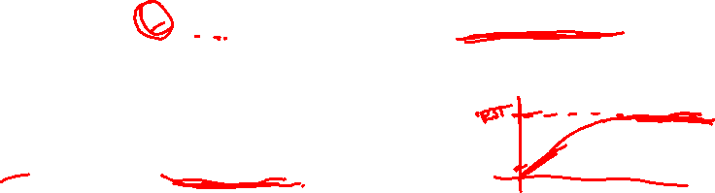
Adaptive Retransmission
Original Algorithm
Measure SampleRTT for each segment/ ACK pair
Compute weighted average of RTT
EstRTT = α x EstRTT + (1 - α )x SampleRTT
α between 0.8 and 0.9
Set timeout based on EstRTT
TimeOut = 2 x EstRTT

Slide 41
Original Algorithm
Problem
ACK does not really acknowledge a transmission
It actually acknowledges the receipt of data
When a segment is retransmitted and then an ACK arrives at the sender
It is impossible to decide if this ACK should be associated with the first or the second transmission for calculating RTTs

Slide 42
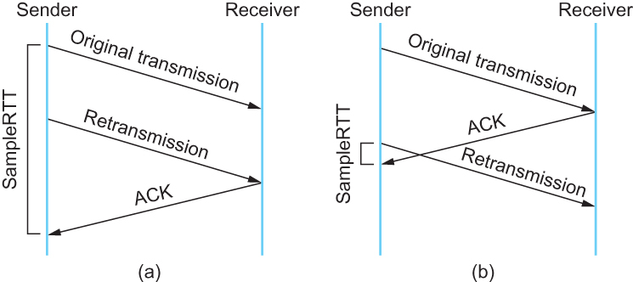
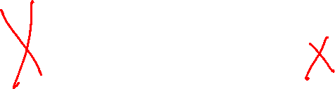
Karn/Partridge Algorithm
Associating the ACK with (a) original transmission versus (b) retransmission

Slide 43
Karn/Partridge Algorithm
Do not sample RTT when retransmitting
Double timeout after each retransmission

Slide 44
Karn/Partridge Algorithm
Karn-Partridge algorithm was an improvement over the original approach, but it does not eliminate congestion
We need to understand how timeout is related to congestion
If you timeout too soon, you may unnecessarily retransmit a segment which adds load to the network

Slide 45
Karn/Partridge Algorithm
Main problem with the original computation is that it does not take variance of Sample RTTs into consideration.
If the variance among Sample RTTs is small
Then the Estimated RTT can be better trusted
There is no need to multiply this by 2 to compute the timeout

Slide 46
Karn/Partridge Algorithm
On the other hand, a large variance in the samples suggest that timeout value should not be tightly coupled to the Estimated RTT
Jacobson/Karels proposed a new scheme for TCP retransmission

Slide 47
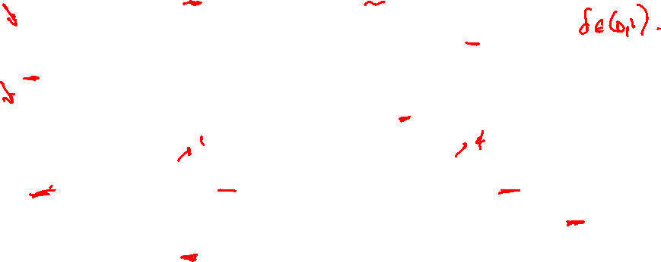
Jacobson/Karels Algorithm
Difference = SampleRTT − EstimatedRTT
EstimatedRTT = EstimatedRTT + ( delta× Difference)
Deviation = Deviation +delta (|Difference| − Deviation)
TimeOut = μ × EstimatedRTT + phi × Deviation
where based on experience, μ is typically set to 1 and phi is set to 4. Thus, when the variance is small, TimeOut is close to EstimatedRTT; a large variance causes the deviation term to dominate the calculation.

Slide 48
Remote Procedure Call (RPC)
While TCP and UDP are often viewed as the complete set of Transport layer protocols, neither exactly meets needs of RPC
There is no single RPC protocol, rather a set of mechanisms to allow requests and responses to be delivered reliably & address the differences in machine architecture at sender and receiver

Slide 49
RPC Fundamentals
Message identification (to match request with response)
Fragmentation/reassembly
Reliability
Marshalling – discussed in later chapter

Slide 50
Perspective
More and more services run over HTTPS
At some point the Internet becomes less an IP-based network and more an HTTP network
This is a new “narrow waist” in the Internet architecture
Less narrow than IP (includes more features like reliability and security)

Slide 51
Summary
We have discussed how to convert host-to-host packet delivery service to process-to-process communication channel.
We have discussed UDP
We have discussed TCP
We have discussed RPC

